Slide 1
Diversity Techniques
Multipath Propogation Fading Diversity Techniques

Slide 2
Multipath Propagation
◆ Reflection - occurs when signal encounters a surface that is large relative to the wavelength of the signal
◆ Diffraction - occurs at the edge of an impenetrable body that is large compared to wavelength of radio wave
◆ Scattering – occurs when incoming signal hitsan object whose size in the order of the wavelength of the signal or less

Slide 3
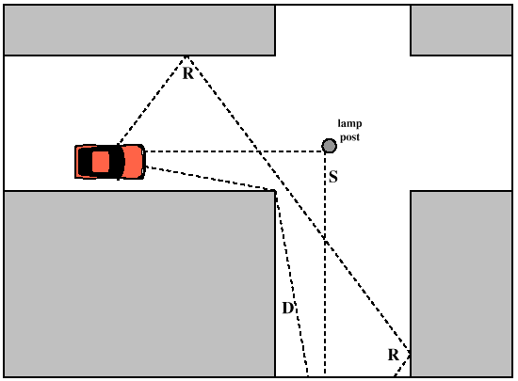
Multipath Propagation

Slide 4
The Effects of Multipath Propagation
◆ Multiple copies of a signal may arrive at different phases
◆ If phases add destructively, the signal level relative to noise declines, making detection more difficult
◆ Inter symbol interference (ISI)
◆ One or more delayed copies of a pulse may arrive at the sametime as the primary pulse for a subsequent bit

Slide 5
Types of Fading
◆ Fast fading -
◆ 900MHz
◆ 20 or 30dB change in amplitude over short distance
◆ Slow fading
◆ Due to change in average received power level to which fluctuation occurs
◆ Flat fading(Non- selective Fading)
◆ In which all frequency components of the received signal fluctuates in the same proportions simultaneously

Slide 6
Types of Fading
◆ Selective fading
◆ affects unequally the different spectral components of a radio signal
◆ Rayleigh fading
occurs when there are multiple indirect paths between transmitter and receiver and no distinct dominant path, such as an LOSpath
◆ Rician fading
◆
◆
best characterizes a situation where there is a direct LOS path in addition to a number of S indirect multipath signals

Slide 7
Error Compensation
Mechanisms
◆ Forward error correction
◆ Adaptive equalization
◆ Diversity techniques

Slide 8
Forward Error Correction
◆ Occurs in digital data
◆ Transmitter adds error-correcting code to data block
◆ Code is a function of the data bits
◆ Receiver calculates error-correcting code from incoming data bits
◆ If calculated code matches incoming code, no error occurred
◆ If error-correcting codes don’t match, receiver attempts to determine bits in error and correct

Slide 9
Adaptive Equalization
◆ Analog voice or video
◆ Digital data, digitized voice or video`
◆ Can be applied to transmissions that carry analog or digital information
◆ Used to combat inter symbol interference (ISI)
◆ Involves gathering dispersed symbol energy back into its original time interval
◆ Techniques
◆ Lumped analog circuits
◆ Sophisticated digital signal processing algorithms

Slide 10
Diversity Techniques
To improve the performance of those fading channels, diversity techniques are used.
Communication channel is supplied with multiple Transmitting and Receiving antennas.
• The signal is transmitted and received through multiple paths.
• As a result, the probability that all replicas of signals will fade simultaneously is reduced considerably.
Fading • Combines the effect of multiple propagation paths, rapid movement of mobile units and reflectors.

Slide 11
Diversity is a powerful communication technique that provides wireless link improvements at relatively low cost
It provides two or more inputs at the receiver such that the fading phenomena among these inputs are uncorrelated.
If one radio path undergoes deep fade another independent path may have a strong signal at that input.

Slide 12
Types of diversity techniques
Space Diversity
Frequency Diversity
Time Diversity
Polarization Diversity
Angle Diversity

Slide 13
Space Diversity
Using antennas spaced enough (at Tx or Rx).
Using more than one antenna to receive the signal.
• More hardware (antennas).

Slide 14
Frequency Diversity
Is implemented by transmitting same information on more than one carrier frequency.
• The separation between the carriers should be at least the coherent bandwidth
• Different copies undergo independent fading.

Slide 15
Time Diversity
Repeatedly transmits information at the time spacing that exceeds the coherence time of the channel.
• The interval between transmission of same symbol should be at least the coherence time
• Different copies undergo independent fading. • Reduction in efficiency (effective data rate < real data rate)
RAKE Receivers(CDMA)
Modern implementation of time diversity involves the use of RAKE receiver for spread spectrum CDMA

Slide 16
Polarization Diversity
Uses antennas of different polarizations i.e. horizontal and vertical.
• The antennas take advantage of the multipath propagation characteristics to receive separate uncorrelated signals.

Slide 17
Angle Diversity
Angle diversity: When the operating frequency is _10 GHz, the scattering of signals from transmitter to receiver generates received signals from different directions that are uncorrelated with each other.
Thus, two or more directional antennas can be pointed in different directions at the receiving site and provide signals for a combiner.
This scheme is more effective at the mobile station than at the base station since the scattering is from local buildings and vegetation and is more pronounced at street level than at the height of base station antennas.
Angle diversity can be viewed as a special case of space diversity since it also requires multiple antennas.

